Slide 1
Course Title: Software Testing And Quality Assurance
Course Code: CSE 4495
Section: A
Our Team Members
Name ID
Al-Momen Reyad 011203011
Md. Abdur Rahman 011202260
Md. Kabirul Hossain 011202026
Sonjoy Dey 011202074

Slide 2

PROJECT DESCRIPTION
OrangeHRM
A PHP-based open-source Human Resource Management software streamlining organization’s HRM processes.
Key Features
Employee Management
Recruitment
Performance Appraisals
Leave Management
Time Tracking
Payroll Management
Employee Self-service Portals

Slide 3

LIST OF TOOLS
PHPUnit: Use for Unit Testing.
Apache Jmeter: Use for Performance Testing.
OWASP ZAP: Use for Security Testing
Selenium: Use for Functional Testing.

Slide 4

Selenium
Selenium is an open-source, automated testing tool used to test web applications across various browsers.
Benefit of Selenium
Open Source
Cross-Browser Compatibility
Multi-Language Support
Platform Independence
Automated Regression Testing

Slide 5
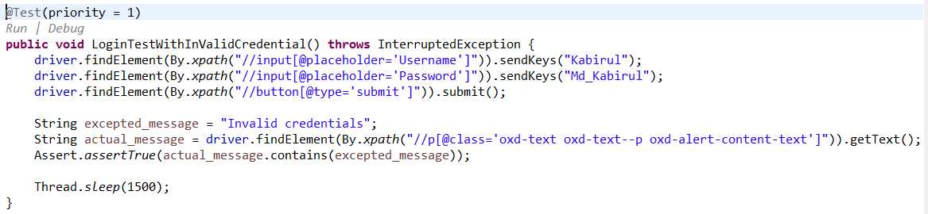
Scenario 01: Login(With Invalid Credential)
Open Login Page → Invalid Credential → Click submit → Provide error message
Purpose: Prevent Unauthorized access.
Expected Output: The system shows an error message.
Test Case Result: Pass

Slide 6
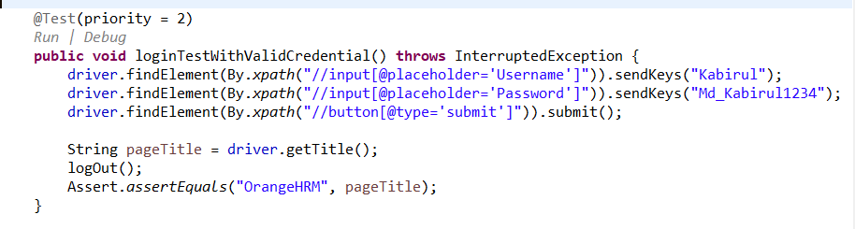
Scenario 01: Login(With Valid Credential)
Open Login Page → Valid Credential → Click submit → Dashboard →Logout
Purpose: Attempt to login with valid username and password.
Expected Output: The user go to the dashboard.
Test Case Result: Pass

Slide 7
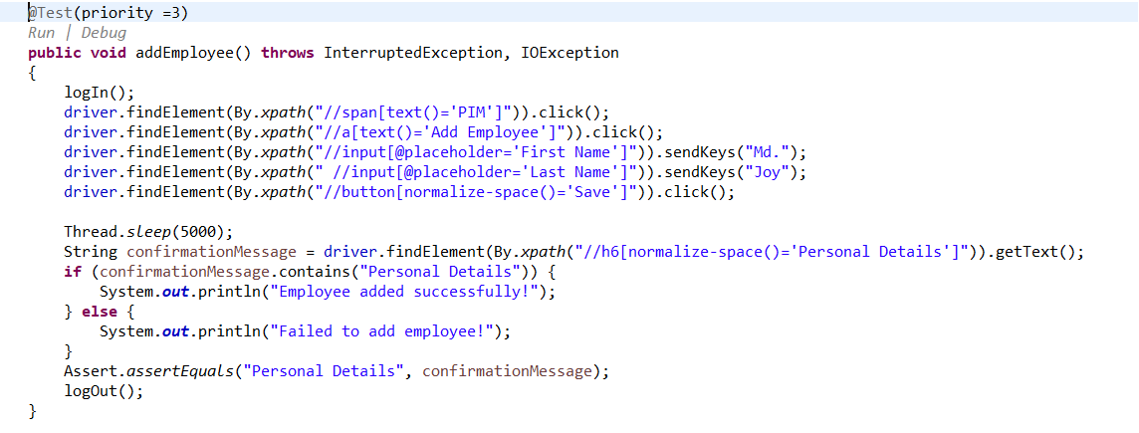
Scenario 02: Add Employee
Login → Navigate to PIM → Add Employee →Fill require details → click save button → Logout.
Purpose: To check whether new employee data is added to the employee list
Expected Output: Successfully add Employees data and store in the system.
Test Case Result: Pass

Slide 8
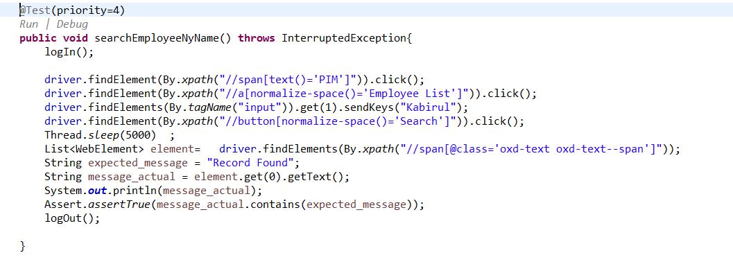
Scenario 03 : Search Employee
Login → Navigate to PIM → Select Employee list →Search by exist name → click search button → Verify → Logout.
Purpose: Validate Data Retrieval.
Expected Output: Record Found
Test Case Result: Pass

Slide 9
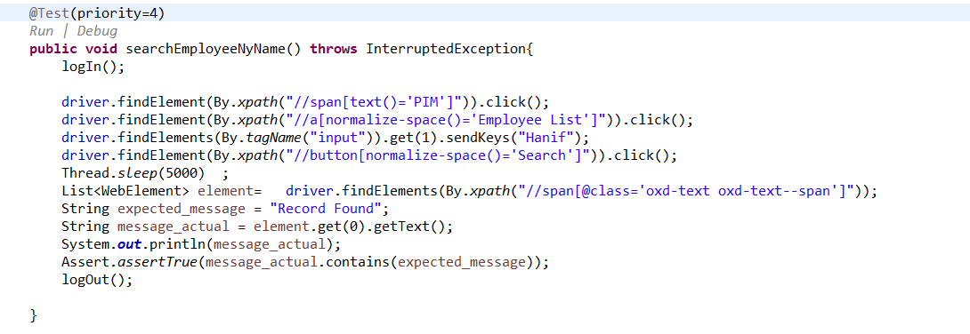
Scenario 03 : Search Employee
Login → Navigate to PIM → Select Employee list →Search by missing name → click search button → Verify → Logout.
Purpose: Validate Data Retrieval.
Expected Output: No Record Found
Test Case Result: Fail

Slide 10
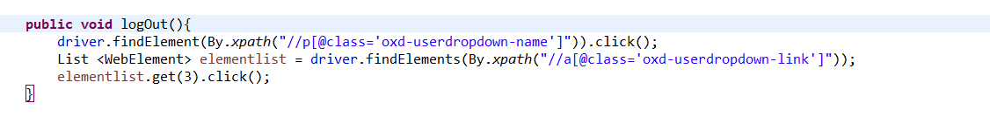
Logout

Slide 11

Apache JMeter
Apache JMeter is a popular open-source tool for performance and load testing.
Benefit of Apache JMeter
Open-source and free
Cross-platform compatibility
User-friendly interface
Extensive protocol support
Integration capabilities
Effective parametrization

Slide 12
Load testing
Test scenarios
Landing page
Admin
Desh Board
Directory

Slide 13
Landing page
Thread Group Number of Threads (User): 100
Ramp-up period(Second):1
Loop count:1
HTTP Request (GET)
IP: localhost
Path: /

Slide 14
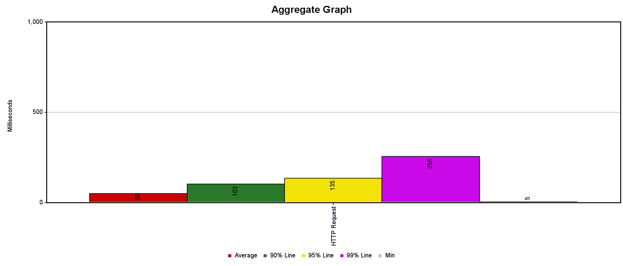

Slide 15
Dashboard
Thread Group Number of Threads (User): 100
Ramp-up period(Second):1
Loop count:1
HTTP Request (GET)
IP: localhost
Path: /orangehrm-5.7/web/index.php/dashboard/index

Slide 16
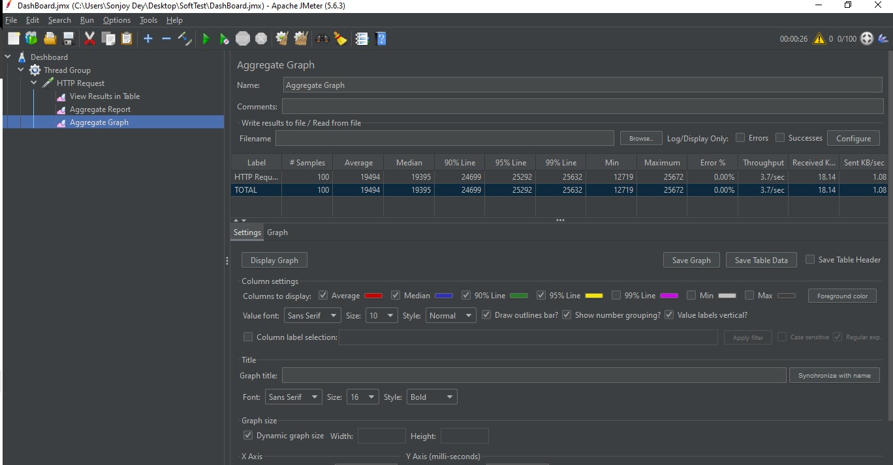

Slide 17
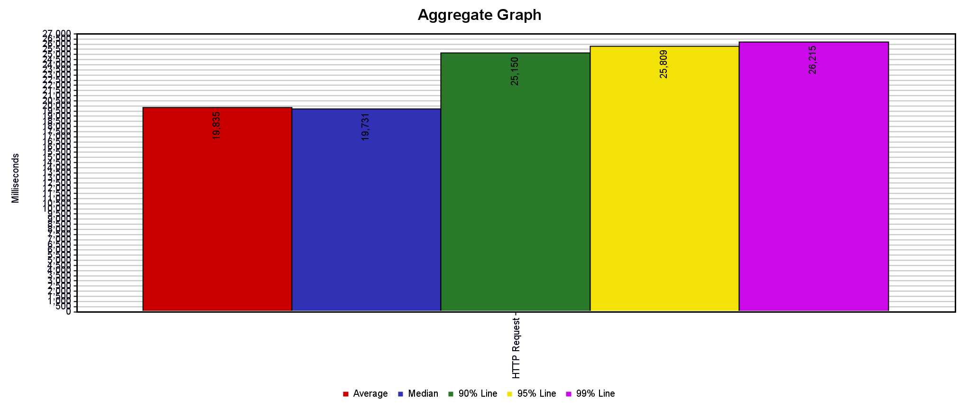

Slide 18
Admin
Thread Group Number of Threads (User): 100
Ramp-up period(Second):1
Loop count:1
HTTP Request (GET)
IP: localhost
Path: /orangehrm-5.7/web/index.php/admin/viewSystemUsers

Slide 19
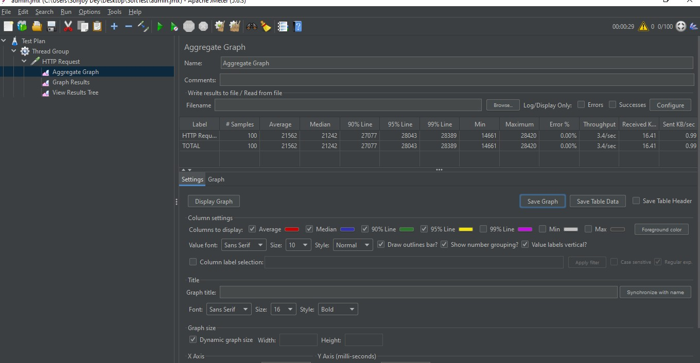

Slide 20
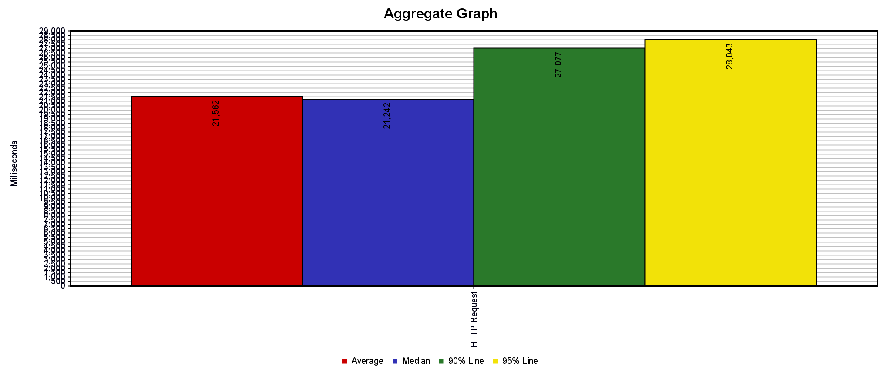

Slide 21
Directory
Thread Group Number of Threads (User): 200
Ramp-up period(Second):1
Loop count:1
HTTP Request (GET)
IP: localhost
Path: /orangehrm-5.7/web/index.php/directory/viewDirectory

Slide 22
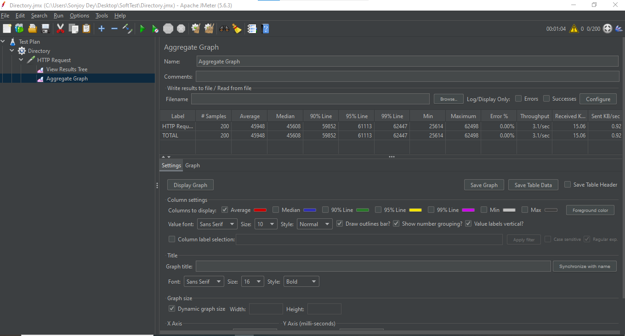

Slide 23
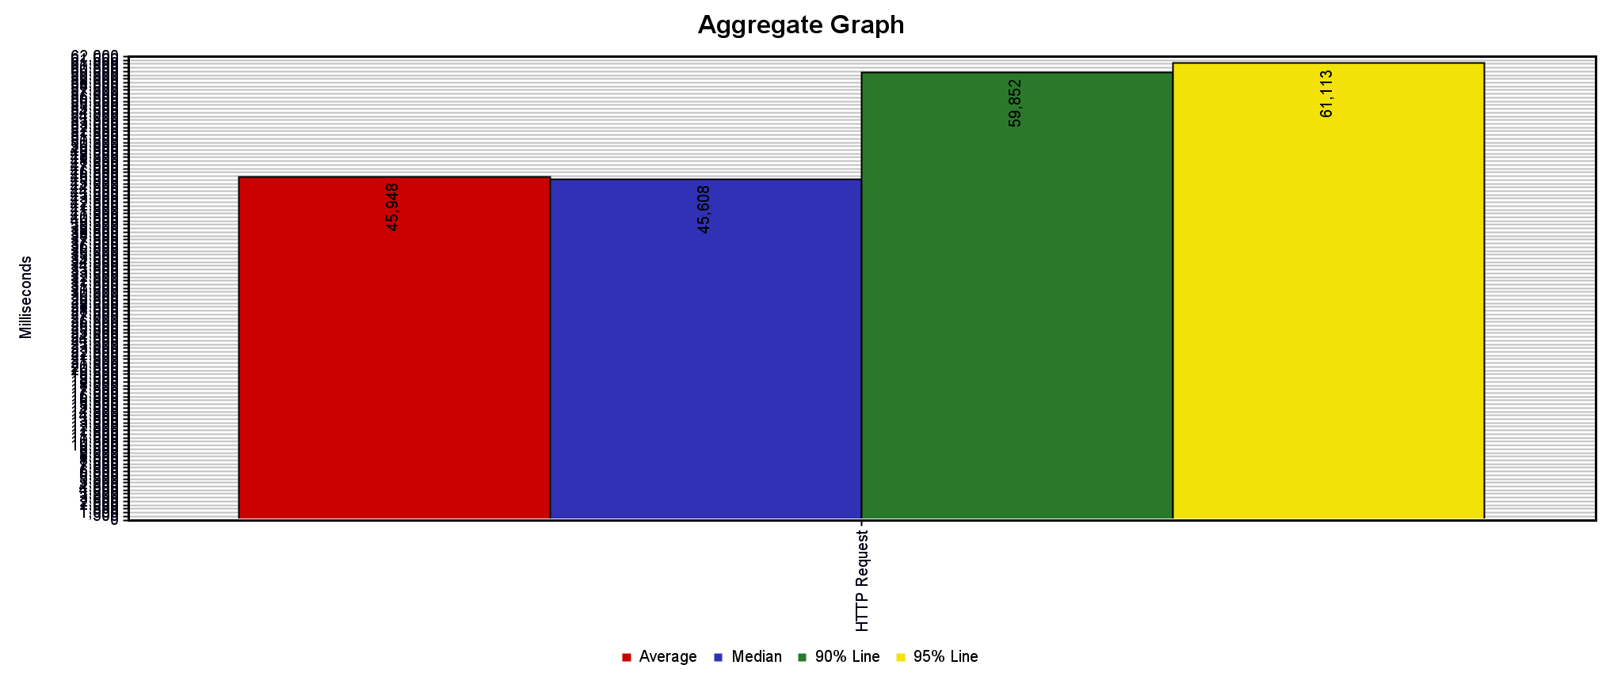

Slide 24




Work Distribution
Al-Momen Reyad
Abdur Rahman
Md. Kabirul Hossain
Sonjoy Dey

Slide 25

Security Testing: Tool-features
ZAP OWASP:
Fuzzing,
Vulnerability Scanning,
Auto Scanning,
AJAX Spider (web crawler),
Proxy Functionality,
Auth Checking, etc.
Tested Features from Orangehrm:
Vacancy
Candidate Selection
(Valid) User Creation
[and MITM, BFA/dictionary Attack, Tracing]

Slide 26
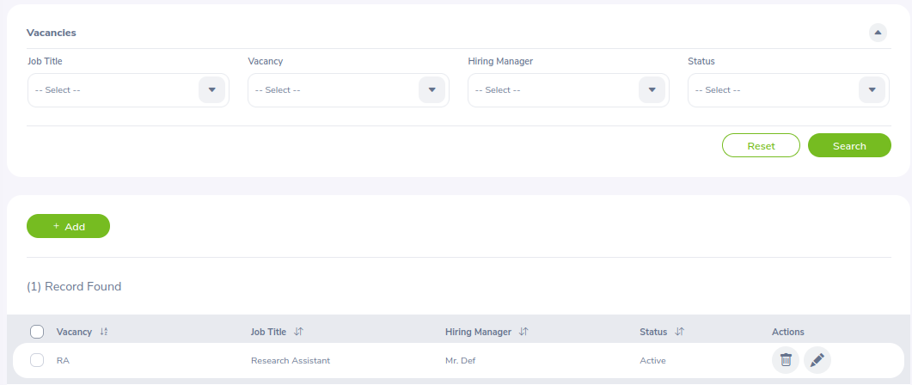
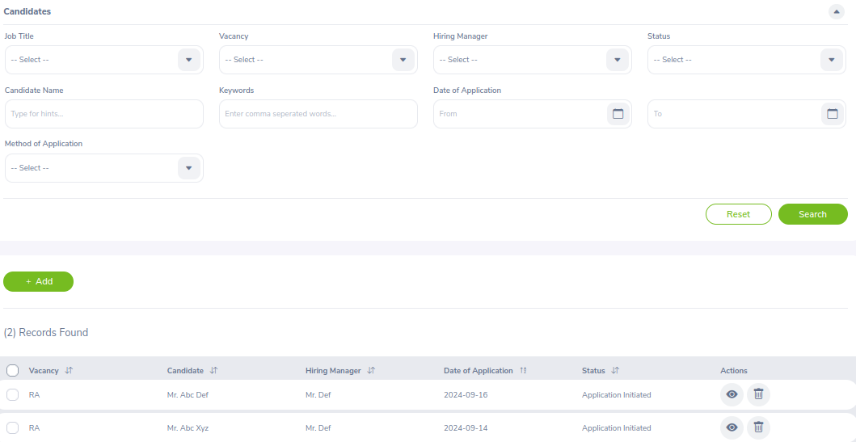
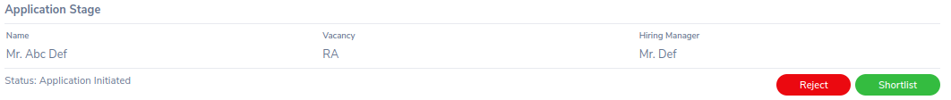
Vacancy and Candidate Selection:
2
1
3

Slide 27
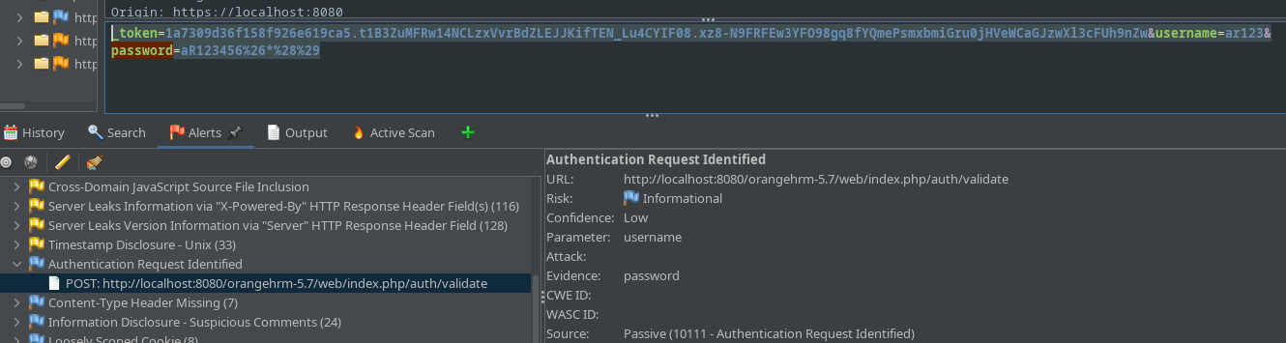

Ajax Crawler +
Vulnerability
test scripts

Slide 28
For the vacancy post made by employee with ID 0004:
Emp_ID | Employee Type | Can approve/reject Candidate | Test Result
0001 | Admin | Yes | Passed
0002 | Normal | No | Passed
0003 | Normal | No | Passed
0004 | Normal (post maker) | Yes | Passed

Slide 29
Security Testing: Findings from Vacancy and Candidate selection
Admin can delete all applications (!)
Each of the vacancy-post can be deleted by the respective each Hiring Manager
An employee cannot delete another employees’ post
No such log-file found (regarding who deleted whose vacancy post)

Slide 30
Security Testing: User Creation
Mandatory entries for creating valid user:
user id
username
password
mail
USER ID (4) | USERNAME (5) | PASSWORD (8) | MAIL (contain @)
0000 < id <= 9999 | “ “ | “” | “[*]@”
10000<= id | “#”, “%”, “*”, “!”, “...” | “[0-9]\d{8}” | “@[*]”
0>= id | “[A-z]\d{5}” | “[A-z]\d{8}” | “[*]@[*]”
 | “[A-z][any symbol]\d{5}” | “[A-z][*#]\d{8}” | “[*]@[*].com”
 | “username' OR '1'='1”

Slide 31
Security Testing: User Creation
Initially: 4 * 5 * 4 * 4 = 320
Passed cases:
EMPLOYEE ID (4) | USERNAME (5) | PASSWORD (8) | MAIL (contain @)
0000 < id <= 9999 | “[A-z]\d{5}” | “[A-z][*#]\d{8}” | “[*]@[*].com”
 | “[A-z][any symbol]\d{5}”
test case code at: drive
Notes:
Code was configured to have user id of 5 integer digits (0001 to 9999); username had to contain at least 5 digits; password needed 8<= chars (special chars included); and mail must contain ‘@’ and ‘.com’

Slide 32

TOOLS OVERVIEW

Slide 33
PHPUnit
PHPUnit is a popular testing framework for PHP. It automates the process,
ensuring your code behaves as expected.
Benefit of PHPUnit:
Automated Testing
Supports TDD(Test Driven Development) practices
Provides detailed test reports
Wide Adoption and Community Support
Standardized Testing

Slide 34
Unit Testing: Leave Assign Testing
Test ID | Function | Description | Input Data | Expected Output | Actual Output | Status
TC1 | testAssignLeaveProperties() | Validate leave assignment | Employee: Asif Iqbal, Leave Type: Medical, Leave Date: 2021-10-01 | Date: 2021-10-01, Length: 8 hours, 1 day, Status: 2, Correct Employee, Leave Type | Leave date: 2021-10-01, length: 8 hours, 1 day, status 2, correct employee, leave type | Pass

Slide 35
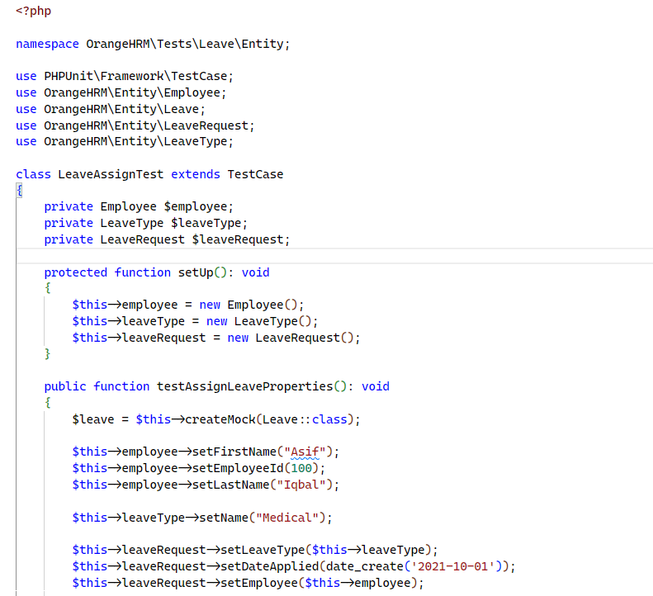
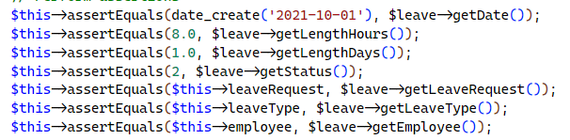
Output: PS C:\xampp\htdocs\orangehrm-5.7 (2)\orangehrm-5.7> .\vendor\bin\phpunit --testsuite Leave
PHPUnit 11.3.6 by Sebastian Bergmann and contributors.
Runtime: PHP 8.2.4
Configuration: C:\xampp\htdocs\orangehrm-5.7 (2)\orangehrm-5.7\phpunit.xml 1/1 (100%)
Time: 00:00.051, Memory: 10.00 MB
Tests: 1, Assertions: 8, PHPUnit Deprecations: 1.

Slide 36
Unit Testing: Education Test
Test ID | Function | Description | Input Data | Expected Output | Actual Output | Status
TC1 | testSetAndGetId() | Test setting and getting Education ID | ID: 1 | 1 | 1 | Pass
TC2 | testSetAndGetName() | Test setting and getting education name | Name: Bachelor of Science | Bachelor of Science | Bachelor of Science | Pass

Slide 37
Unit Testing: Education Test Case Study
Objective: Verify that users/HR can add education qualifications to an employee's profile in OrangeHRM.
Preconditions: User is logged in and has permission to edit employee education details.
Workflow:
Login
PIM
Employee List
Select an Employee
Qualification Tab
Select Level
Add Education

Slide 38
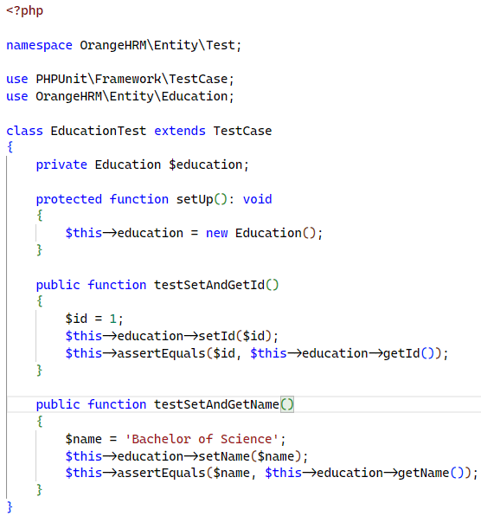
Output: PS C:\xampp\htdocs\orangehrm-5.7 (2)\orangehrm-5.7> .\vendor\bin\phpunit --testsuite Admin
PHPUnit 11.3.6 by Sebastian Bergmann and contributors.
Runtime: PHP 8.2.4
Configuration: C:\xampp\htdocs\orangehrm-5.7 (2)\orangehrm-5.7\phpunit.xml
.... 4 / 4 (100%)
Time: 00:00.043, Memory: 12.00 MB
Tests: 2, Assertions: 2, PHPUnit Deprecations: 1.

Slide 39
Unit Testing: Attendance Record Test
Test ID | Function | Description | Input Data | Expected Output | Actual Output | Status
TC1 | testAttendanceRecordEntityPunchIn () | Verifies punch in functionality | PunchInUtcTime: 5:30, PunchInNote: "started work", PunchInTimeOffset: +05:30, PunchInUserTime: 11:00, State: PUNCH IN | PunchInUtcTime: 5:30, State: PUNCH IN | PunchInUtcTime: 5:30, State: PUNCH IN | Pass
TC2 | testAttendanceRecordEntityPunchOut () | Verifies punch out functionality | PunchOutUtcTime: 12:30, PunchOutNote: "ended work", PunchOutTimeOffset: +05:30, PunchOutUserTime: 18:00, State: PUNCH OUT | PunchOutUtcTime: 12:30, State: PUNCH OUT | PunchOutUtcTime: 12:30, State: PUNCH OUT | Pass

Slide 40
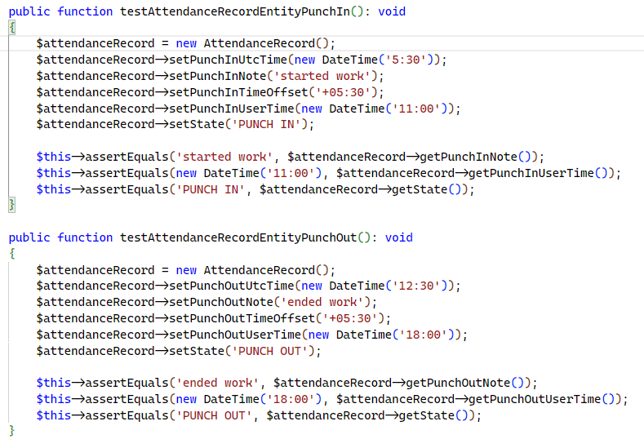
Output: PS C:\xampp\htdocs\orangehrm-5.7 (2)\orangehrm-5.7> .\vendor\bin\phpunit --testsuite Attendance
PHPUnit 11.3.6 by Sebastian Bergmann and contributors.
Runtime: PHP 8.2.4
Configuration: C:\xampp\htdocs\orangehrm-5.7 (2)\orangehrm-5.7\phpunit.xml … 2 / 2 (100%)
Time: 00:00.227, Memory: 10.00 MB
Tests: 2, Assertions: 6, PHPUnit Deprecations: 1.

Slide 41
Thank You

